Slide 1
Chapter 6
Ordinary Differential Equation

Slide 2
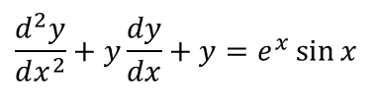

DE: A differential equation (DE) is an equation that involves differentials or derivatives.
An equation involving a function of one independent variable and its (ordinary) derivatives is called an ordinary differential equation (ODE).
For example the equation
and
are ordinary differential equation as it contains only ordinary derivatives.
$$\frac{dy}{dx}+2y=5$$
$$\frac{d^{2}y}{dx^{2}}+y\frac{dy}{dx}+y=e^{x}\sin{x}$$

Slide 3

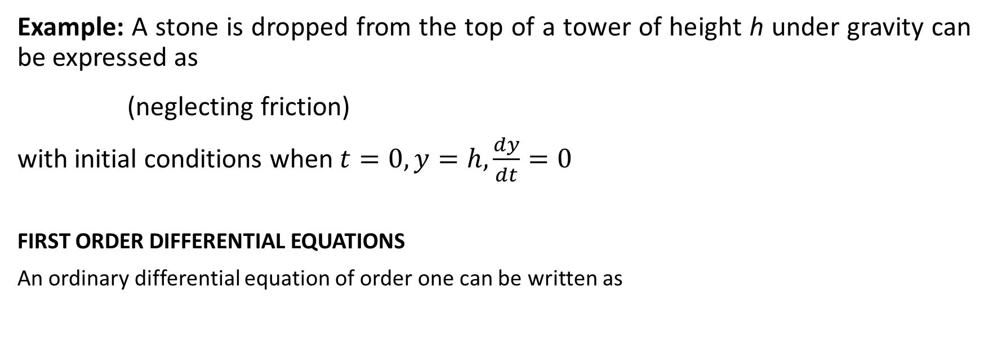

Initial Value Problem (IVP) If a differential equation is required to satisfy conditions on the dependent variable and its derivatives specified at one value of the independent variable, these conditions are called initial conditions and the problem is called initial value problem (IVP).
.
Example: A stone is dropped from the top of a tower of height h under gravity can be expressed as
(neglecting friction)
with initial conditions when $t=0, y=h,\frac{dy}{dt}=0$
FIRST ORDER DIFFERENTIAL EQUATIONS
An ordinary differential equation of order one can be written as
$$\frac{d^{2}y}{dt^{2}}=g$$
$$\frac{dy}{dx}=f(x,y)$$

Slide 4

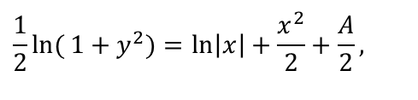
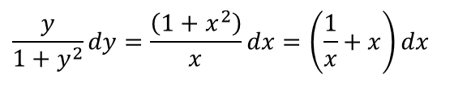
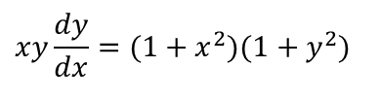
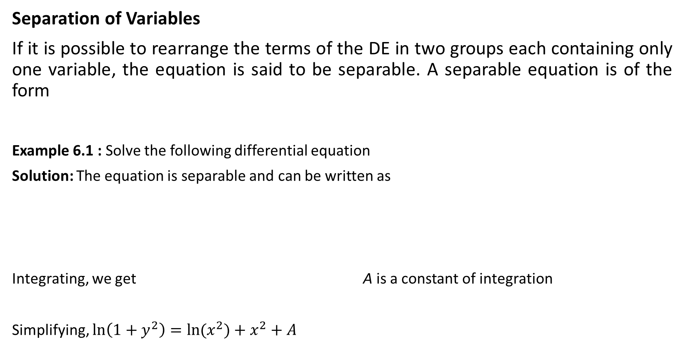
Methods of Solution
Separation of Variables
If it is possible to rearrange the terms of the DE in two groups each containing only one variable, the equation is said to be separable. A separable equation is of the form
Example 6.1 : Solve the following differential equation
Solution: The equation is separable and can be written as
Integrating, we get A is a constant of integration
Simplifying, $\ln\left(1+y^{2}\right)=\ln{{(x}^{2}})+x^{2}+A$
$$\frac{dy}{dx}=f(x)g(y)$$
$$xy\frac{dy}{dx}=(1+x^{2})(1+y^{2})$$
$$\frac{y}{1+y^{2}}dy=\frac{\left(1+x^{2}\right)}{x}dx=\left(\frac{1}{x}+x\right)dx$$
$$\frac{1}{2}\ln{(}1+y^{2})=\ln\left|x\right|+\frac{x^{2}}{2}+\frac{A}{2},$$

Slide 5
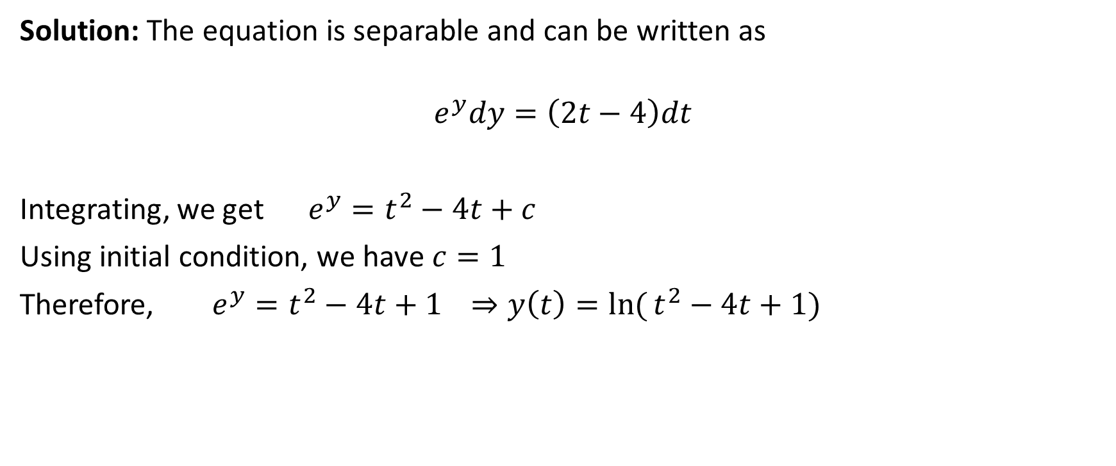
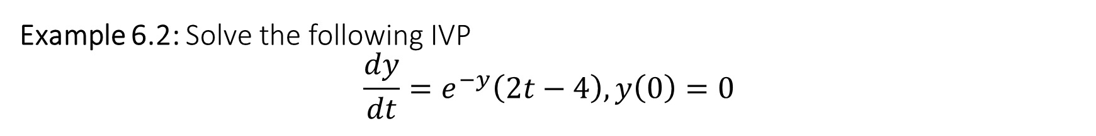
Example 6.2: Solve the following IVP $$\frac{dy}{dt}=e^{−y}\left(2t−4\right), y\left(0\right)=0$$
Solution: The equation is separable and can be written as
$$e^{y}dy=\left(2t−4\right)dt$$
Integrating, we get $e^{y}=t^{2}−4t+c$
Using initial condition, we have $c=1$
Therefore, $e^{y}=t^{2}−4t+1$ $⇒y\left(t\right)=\ln{(}t^{2}−4t+1)$

Slide 6


Example 6.3: Solve the following initial value problem
$$\frac{dy}{dx}=\frac{1+y^{2}}{1+x^{2}}, y(0)=1$$
Solution: The equation is separable and can be written as
$\frac{dy}{1+y^{2}}=\frac{dx}{1+x^{2}}$
Integrating, we get $\tan^{−1}{y=\tan^{−1}{x+c}}$
Using initial condition, we have $c=\frac{π}{4}$
Therefore, $\tan^{−1}{y=\tan^{−1}{x+\frac{π}{4}}}$ .

Slide 7

Class Practice: Find the solution of the following DEs using separation of variables
$\frac{dy}{dt}=\left(t−1\right), y\left(0\right)=2$
$\frac{dy}{dt}=\frac{y}{1+y^{2}}$
$\frac{dy}{dt}=\frac{t}{y^{2}}, y\left(1\right)=1$
$xy^{3}dx+e^{x^{2}} dy=0$
Home work: P-34: 5-34
Differential Equations – P. Blanchard, R. L. Devaney, G. R. Hall (4th edition)

Slide 8
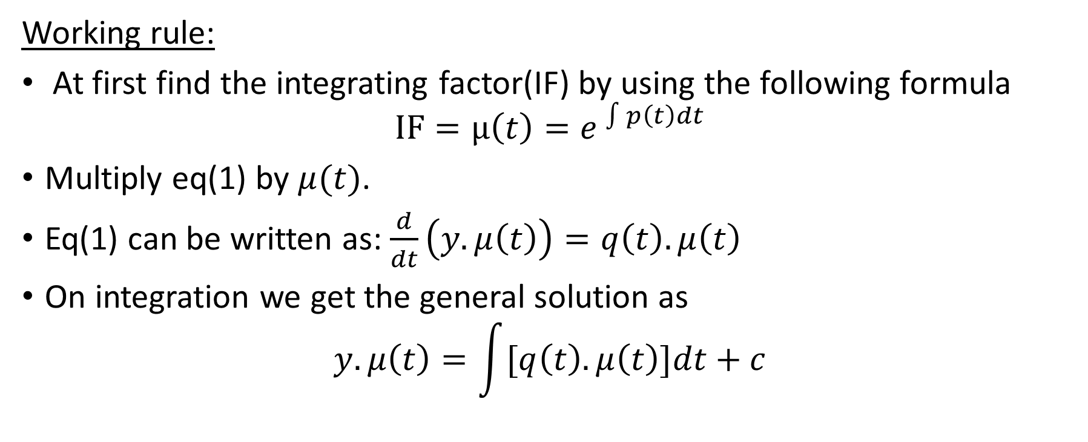

First Order Linear Differential Equations (General Form): $\frac{dy}{dt}+p\left(t\right)y=q(t)$……(1)
Working rule:
At first find the integrating factor(IF) by using the following formula
$$IF=μ\left(t\right)=e^{ \int{p\left(t\right)dt}}$$
Multiply eq(1) by $μ(t)$.
Eq(1) can be written as: $\frac{d}{dt}\left(y.μ\left(t\right)\right)=q\left(t\right).μ\left(t\right)$
On integration we get the general solution as
$$y.μ\left(t\right)=\int{[q\left(t\right).μ\left(t\right)]dt+c}$$

Slide 9



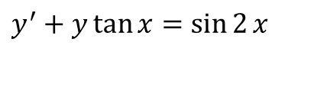
. Example 6.4: Find the general solution of
$$y^{′}+y\tan{x}=\sin{2}x$$
Solution: Here $p\left(x\right)=\tan{x}.$
An integrating factor is $e^{ \int{\tan{x dx}}}=e^{\ln{\sec{x}}}=\sec{x}$ .
Multiplying by $\sec{x}$, we have
$$\frac{d}{dx}\left(y.\sec{x}\right)=(2\sin{x}\cos{x)}\sec{x}=2\sin{x}$$
Integration gives
or
$$y\sec{x}=−2\cos{x}+A$$
$$y=−2\cos^{2}{x}+A\cos{x}$$

Slide 10
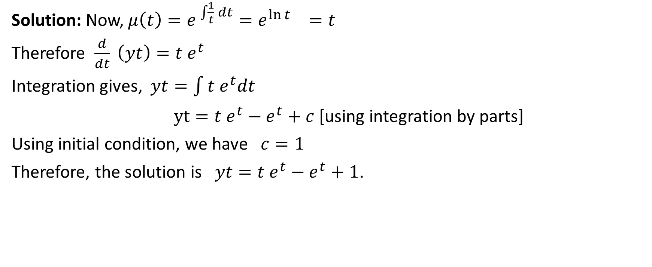
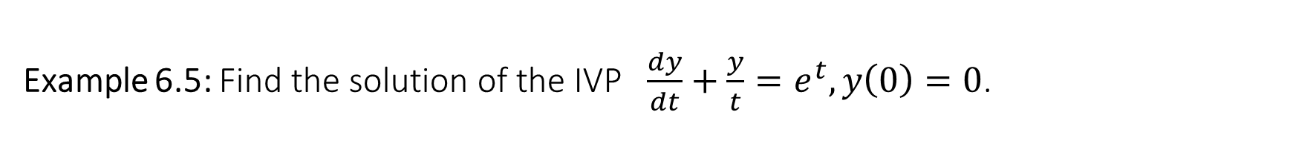
Example 6.5: Find the solution of the IVP $\frac{dy}{dt}+\frac{y}{t}=e^{t}, y\left(0\right)=0$.
Solution: Now, $μ\left(t\right)=e^{ \int{\frac{1}{t} dt}}=e^{\ln{t }}=t$
Therefore $\frac{d}{dt} \left(yt\right)=t e^{t}$
Integration gives, $yt=\int{t e^{t}dt}$
$yt=t e^{t}−e^{t}+c$ [using integration by parts]
Using initial condition, we have $c=1$
Therefore, the solution is $yt=t e^{t}−e^{t}+1$.

Slide 11

Class Practice: Find the solution of the following first order linear DEs
$\frac{dy}{dt}+\frac{2}{t} y=t−1$
$\frac{dy}{dt}−\frac{2y}{t}=2t^{2}, y\left(−2\right)=4$
$\frac{dy}{dt}=−2ty+4 e^{−t^{2}}, y\left(0\right)=3$
$\frac{dy}{dt}=−\frac{y}{1+t}+t^{2}$
Home work: P-133: 1-12
Differential Equations – P. Blanchard, R. L. Devaney, G. R. Hall (4th edition)

Slide 12
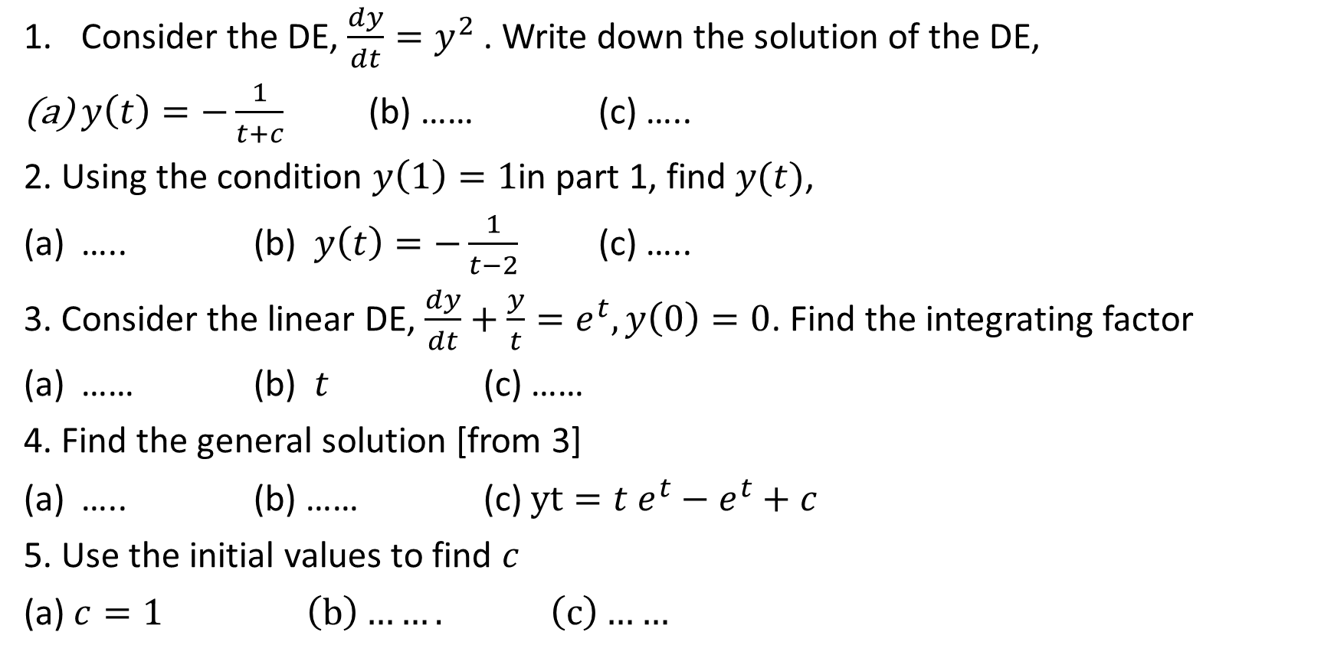
Sample MCQ
Consider the DE, $\frac{dy}{dt}=y^{2}$. Write down the solution of the DE,
$y\left(t\right)=−\frac{1}{t+c}$ (b) …… (c) …..
2. Using the condition $y\left(1\right)=1$in part 1, find $y(t)$,
….. (b) $y\left(t\right)=−\frac{1}{t−2}$ (c) …..
3. Consider the linear DE, $\frac{dy}{dt}+\frac{y}{t}=e^{t}, y\left(0\right)=0$. Find the integrating factor
…… (b) $t$ (c) ……
4. Find the general solution [from 3]
….. (b) …… (c) $yt=t e^{t}−e^{t}+c$
5. Use the initial values to find $c$
(a) $c=1 \left(b\right)……. \left(c\right)……$

Slide 13
THANK YOU

